Slide 1
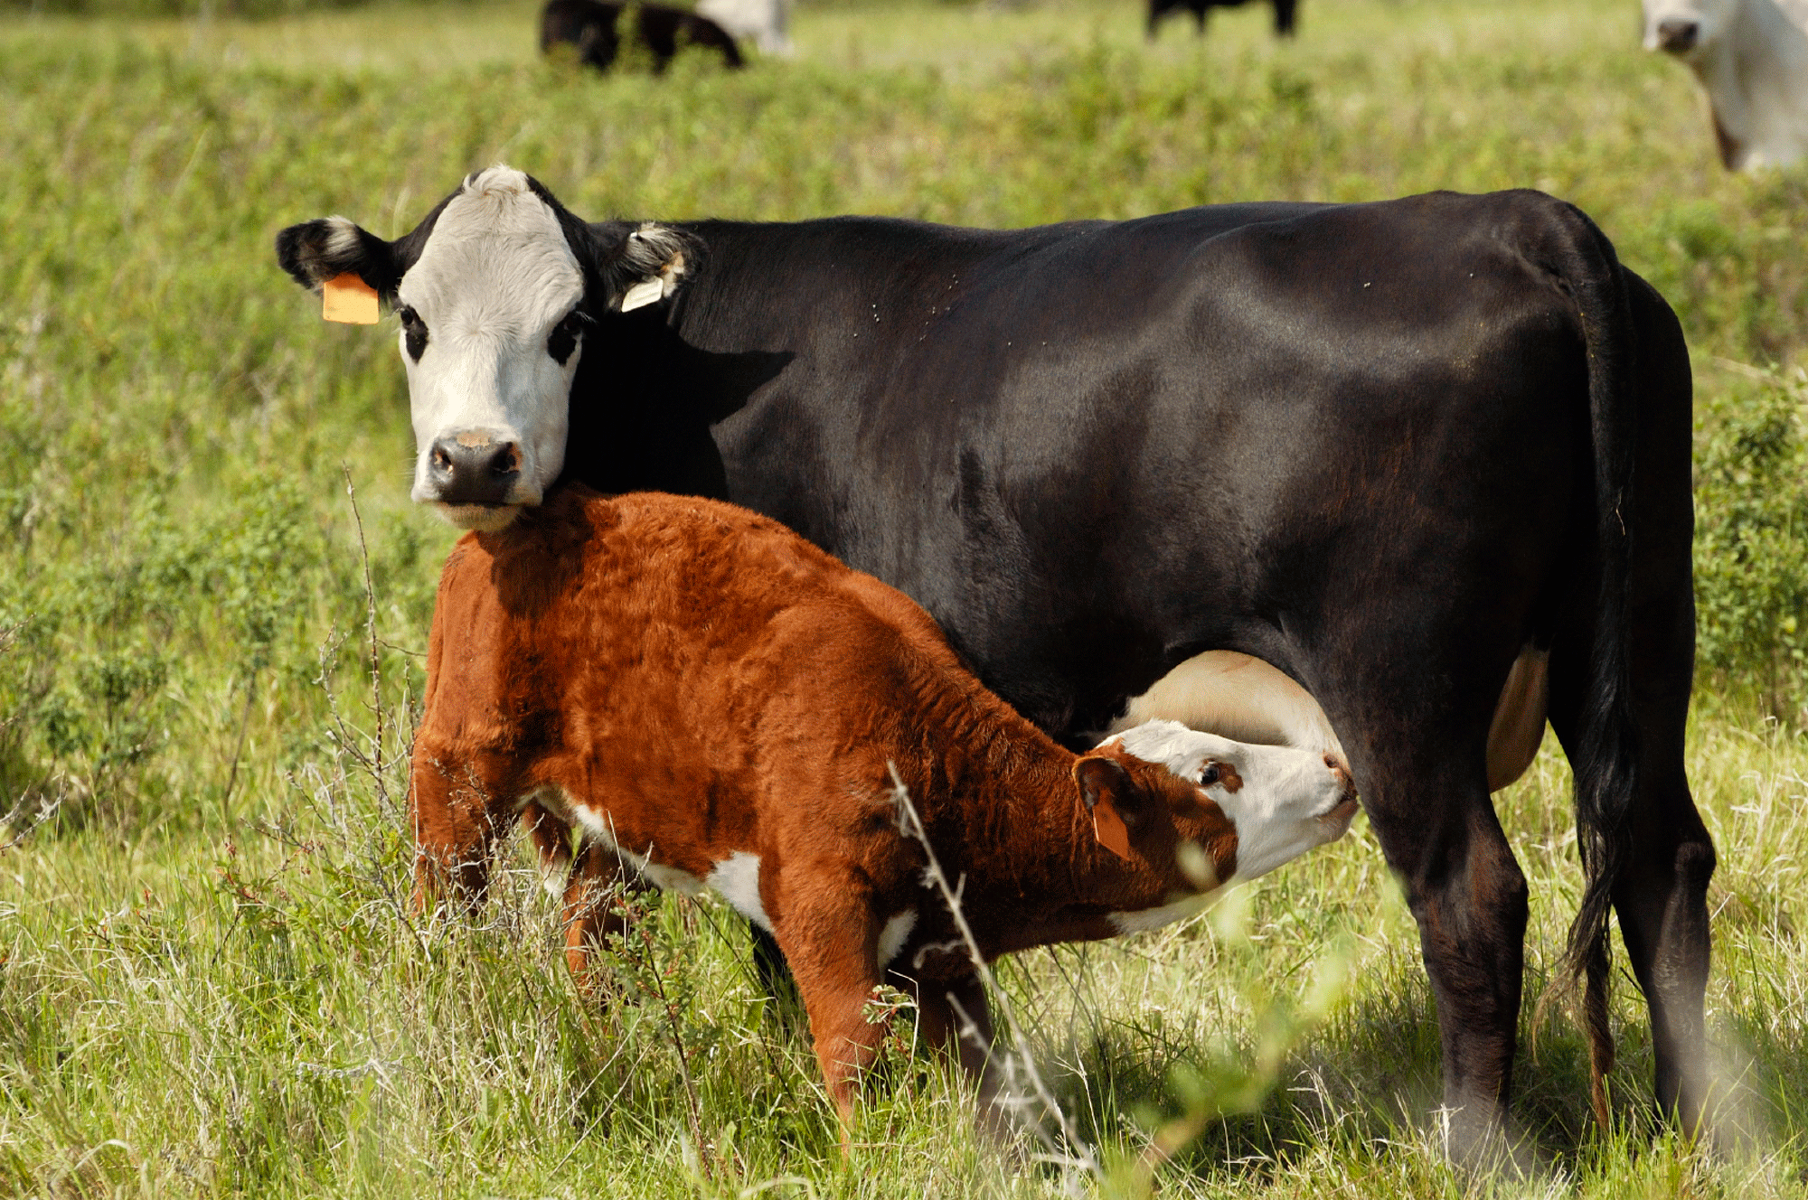
Beef Cattle - Minerals
Cow depreciation: It's real and must be accounted for | Beef Magazine
Michelle South
Assistant Area Extension Agent – Agriculture, Livestock

Slide 2
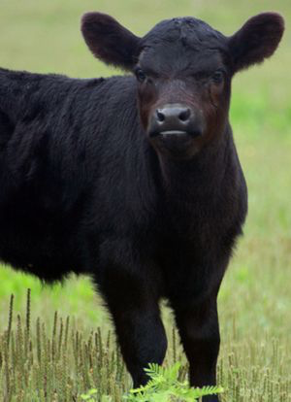
HERD GOALS
Healthy herd
Good body condition on cows
5 to 6
Produce one calf per cow every year
highest possible live calf crop
70% or Above
No dystocia
High weaning weights
ALL ARE AFFECTED BY NUTRITION
Black Angus Calf | Cow calf, Cattle, Cute cows
M. South, 2019

Slide 3
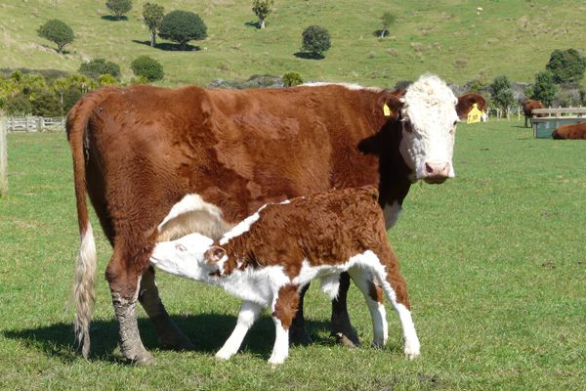
Beef Cattle - Minerals - Nutrition -
Cow nutrition needs to stay high so that calf has plenty of nutritious milk, while maintaining the cow’s requirements.
Adequate Forages
Grass
Hay
Silage
Adequate
Minerals
Hereford | Hereford cattle, Hereford cows, Cow pictures
M. South, 2019

Slide 4
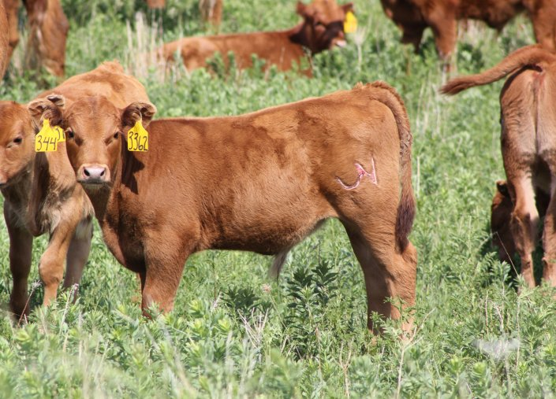
Beef Cattle - Minerals - Nutrients -
Main Nutrients
Water
Vitamins
Minerals
Protein
Energy (Carbohydrates)
Calf Prices By Month - Beef2Live | Eat Beef * Live Better
M. South, 2019

Slide 5
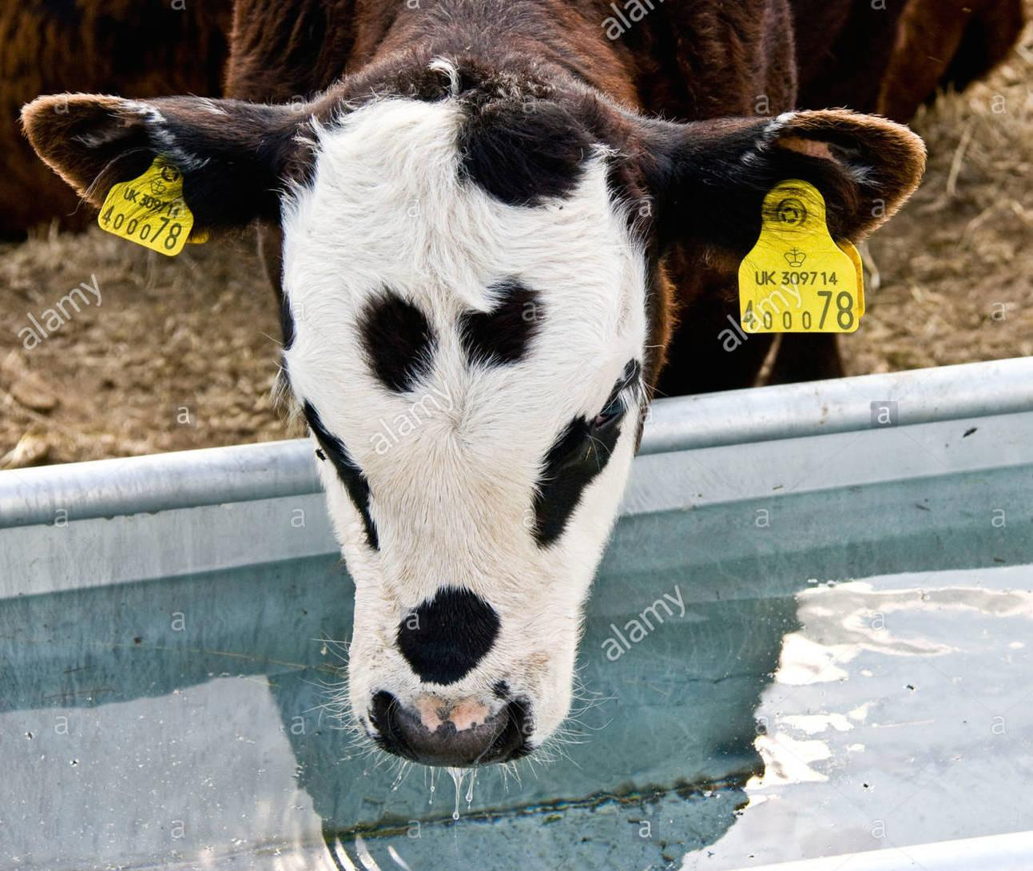
WATER
Clean
De-Iced if possible
Demand increases with temperature or environment
Feed and mineral intake decreases with decrease in water intake
Young calf with identification tags in ears drinking from a water ...
M. South, 2019

Slide 6
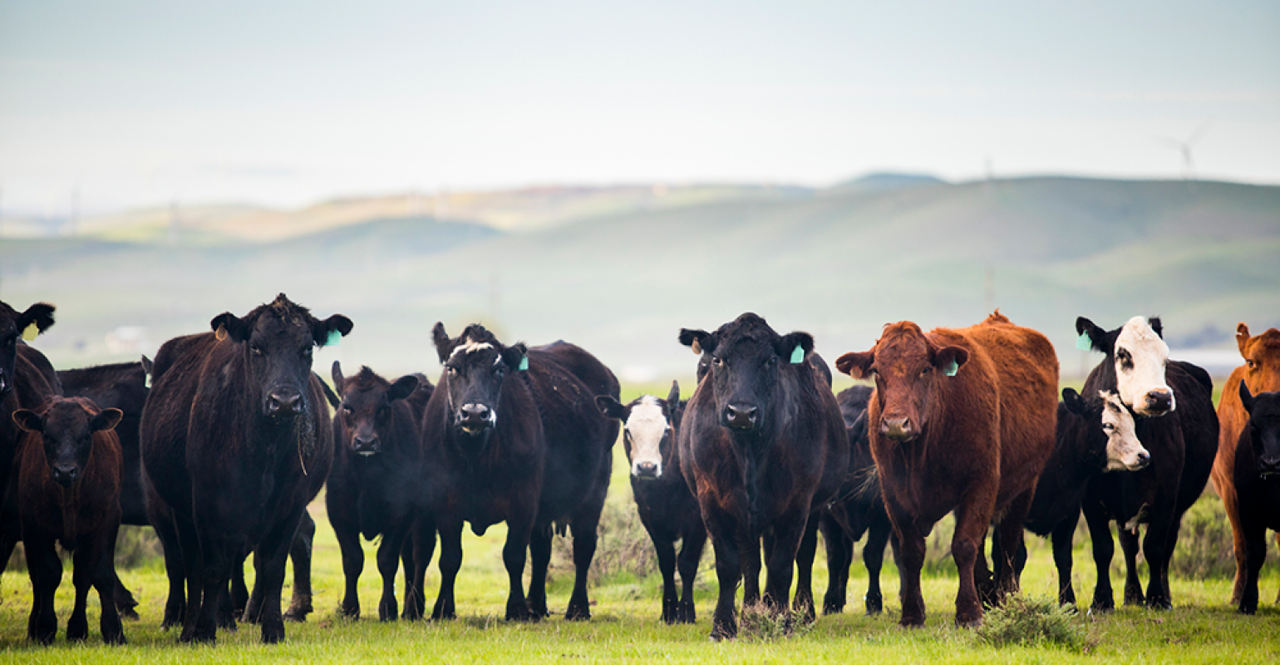
VITAMINS
Essential Vitamins
VITAMIN A
VITAMIN D
VITAMIN E
Non-Essential Vitamins
VITAMIN K
B- VITAMINS
California cattle producers beef up state's cattle business | Beef ...
M. South, 2019

Slide 7
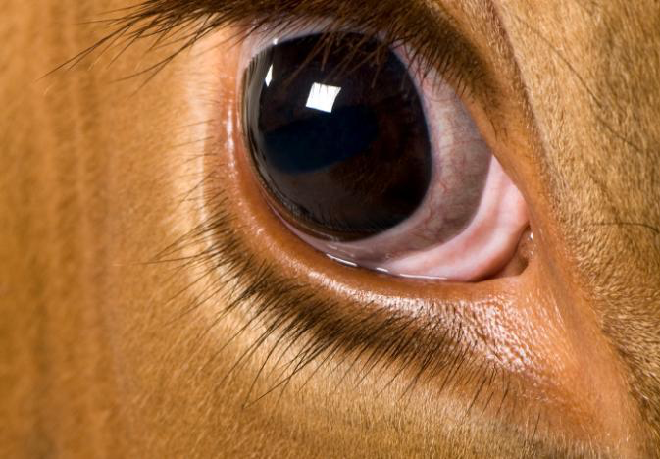
VITAMIN A
METABOLIC FUNCTION
Maintenance of epithelial tissue
Skin
Respiratory system lining
Digestive system lining
Reproductive system lining
Eyesight
Adapting from light to dark
Kidney Function
Development of bones, teeth, and nerve tissue
SOURCES
Mixed rations
Green plants
Grass
The eyes have it: Cows' dominance is shown through sight | Drovers
M. South, 2019

Slide 8
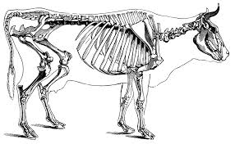
VITAMIN D
Metabolic Function
Increases absorption in digestive tract
Increases metabolic use of calcium and Phosphorous
Formation of bones and teeth
Prevents rickets
Weakening of bones in young animals
Sources
Formed by sunlight exposure
Component in UV Rays is converted to Vitamin D
Sun Cured Plants
Hay
Requirement
Increased in growing animals
cow-skeleton-illustration-id184972282 (1024×634) | 동물 해부학 ...
M. South, 2019

Slide 9
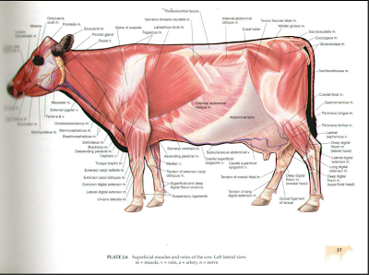
VITAMIN E
Metabolic Functions
Not clear
Takes part in chemical antioxidant that reduces the destruction of other vitamins
Prevention and treatment of White Muscle Disease
Nutritional muscle dystrophy
Muscle degeneration
Sources
Most forages
Whole grains
Located in the oil of the seed
Poultry & Farm Animals Anatomy
M. South, 2019

Slide 10
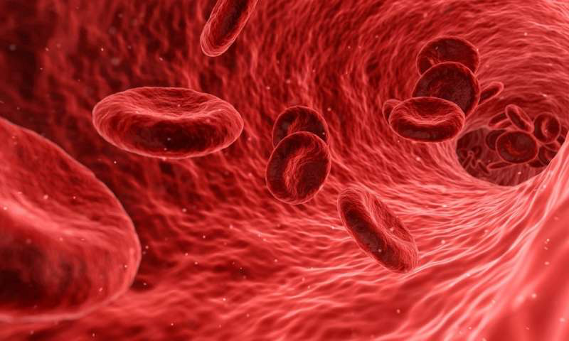
VITAMIN K
Metabolic Functions
Proper liver function
Production of prothrombin
Blood clotting
Source
Healthy rumen bacteria
Deficiency
Moldy sweet clover hay or silage
Component in mold prevents production of Prothrombin
Requirement
May need to be supplemented until young calves establish good rumen flora
Blood-testing startup Theranos said to be closing (Update)
M. South, 2019

Slide 11
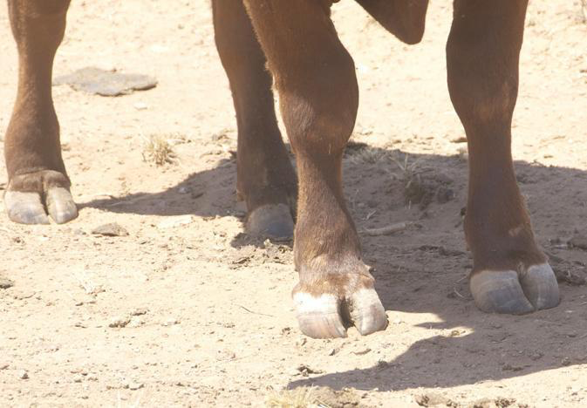
B- VITAMINS
Metabolic function
Body fat mobilization
Breakdown and use
Hoof and hair production
Enzyme production
Brain function
ETC.
Source
Cow’s milk
Healthy rumen bacteria
Deficiency
Not enough forage in diet
Evaluation of Feet and Legs Important for Cattle Longevity | Drovers
M. South, 2019

Slide 12
MINERALS
MACROMINERALS
Required in higher quantities
Calcium
Phosphorous
Sodium
Chlorine
Potassium
Sulfur
Magnesium
MICROMINERALS
Required in lower quantities
Cobalt
Copper
Iodine
Iron
Manganese
Selenium
Zinc
M. South, 2019

Slide 13
MACROMINERALS
PHOSPHOROUS
Metabolic Function
Bone growth
Skeletal function
Energy metabolism
Formation of enzymes
Formation of genetic material
Source
Soybean meal
Mixed rations
Concentrates
Requirements
Increased in young animals
Low in most forages, so grass fed only animals will need supplementation
CALCIUM
Metabolic Function
Bone development
Muscle contraction
Milk production
Nerve conduction
Blood clotting
Source
Grasses
Legumes
Requirements
Increased in young animals
Animals fed just grain or corn silage need supplementation
Corn is low in calcium
M. South, 2019

Slide 14
MACROMINERALS
SODIUM and CHOLRINE (SALT)
Metabolic Function
Proper function of neural and muscular system
Regulate body’s pH and water balance
Transmission of nerve impulses
Source
Loose Free Choice Minerals
Requirements
Calves fed silage will consume more Salt
POTASSIUM
Metabolic Function
Acid-base balancing
Osmotic pressure
Water retention
Source
Lush grasses
Good quality hay
Loose free choice minerals
Requirements
May need supplementation in winter if hay was rained on or of fair quality
M. South, 2019

Slide 15
MACROMINERALS
SULFUR
Metabolic Functions
Protein synthesis
Hair growth
Milk production
Enzyme activity
Hormone activity
Hemoglobin
Connective tissue formation
Source
Distiller’s grains
Corn gluten
Mixed rations
Loose free choice minerals
Occasionally water
Requirements
Grass fed only cattle will need supplementation
Can be fed in excess which will lead to copper deficiency
MAGNESIUM
Metabolic Functions
Enzyme function
Carbohydrate metabolism
Nervous system function
Source
Loose free choice minerals
Requirements
Need to be supplemented
Especially in spring when grasses are very lush
Grass Tetany can occur
M. South, 2019

Slide 16
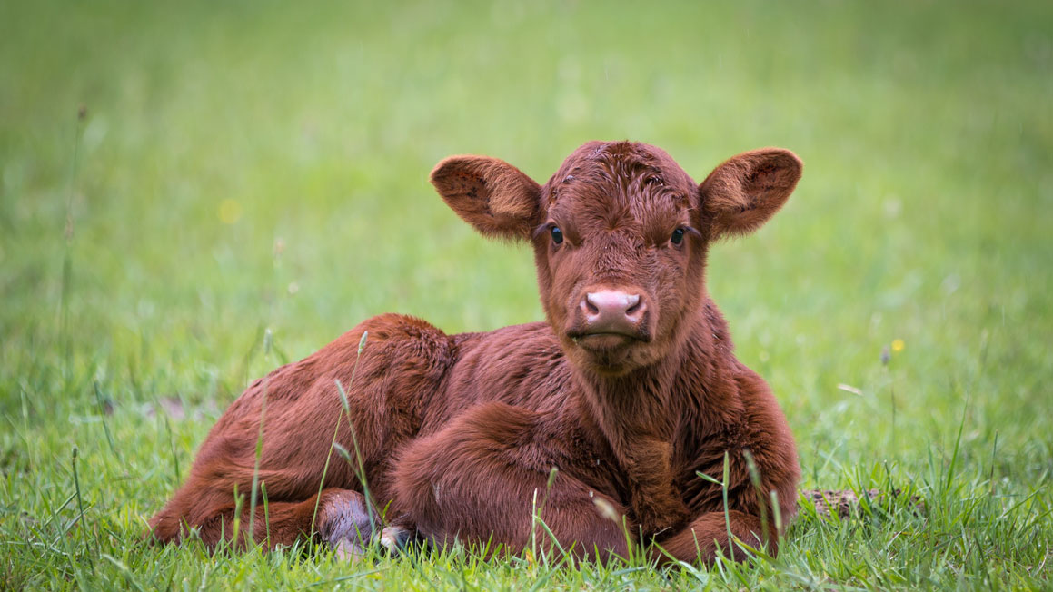
MICROMINERALS
COBALT
Metabolic Functions
Component of Vitamin B-12
Nervous system function
Formation of red blood cells
Source
Rumen bacteria
Loose free choice minerals
Requirements
Typically supplemented to ensure that deficiency does not occur
A Watched Cow Never Calves - Growing Georgia
COPPER
Metabolic Functions
Enzyme systems needed for normal growth and maintenance
Source
Loose free choice Minerals
Requirements
Increased in growing animals
Most common mineral deficiency in cattle
M. South, 2019

Slide 17
MICROMINERALS
IRON
Metabolic Function
Formation of hemoglobin
Source
Forages
Loose free choice minerals
Requirements
Not typically needed in animals that are grazing
May need to be supplemented during winter, if hay is not of good quality
MANGANESE
Metabolic Function
Normal reproduction
Fetal development
Udder development
Source
Forages
Loose free choice minerals
Requirements
Deficiency is rare in grazing cattle
May need to supplement cattle in winter or if one corn grain diet
IODINE
Metabolic Function
Thyroid hormone function
Energy metabolism
Source
Loose free choice Minerals
Requirements
Deficiencies are rare in cow herds but can be seen in newborns
M. South, 2019

Slide 18
MICROMINERALS
SELENIUM
Metabolic Functions
Muscle function
Proper reproductive performance
Source
Loose free choice minerals ONLY
Requirements
Selenium can cause a muscle wasting and scours if deficient
Can be very toxic if not given in the appropriate amount
ONLY USE PRE-MIXES
ZINC
Metabolic Functions
Enzyme function
Immunity
Male reproduction
Skin and hoof growth
Source
Some forages
Loose free choice minerals
Requirements
Increased for growing animals
M. South, 2019

Slide 19
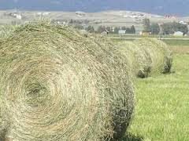
FORAGES
Good quality forages are ideal and needed for optimal growth
Source of many nutrients
Calves need unlimited access to dry forage
Don’t want them to have to fight for forage
Put enough hay out that will be eaten without waste, but will allow calves the chance to eat without too many cows crowding hay.
Without adequate forages rumen microbes can not properly function
Leads to deficiencies and health problems
Hay - Wikipedia
M. South, 2019

Slide 20
PROVIDING MINERALS
Beef cattle regulate own intake of vitamins and minerals
Need UNLIMITED FREE CHOICE ACCESS
Allows cattle to meet own requirements
Easy access feeders
Some can be expensive $$$
DIY FEEDER → Cheaper → Money Saved
M. South, 2019

Slide 21
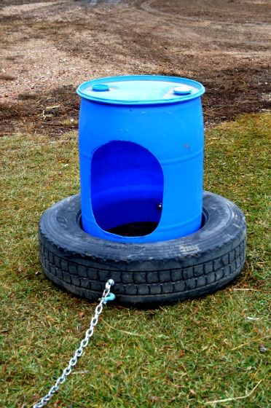
DYI FEEDER
CHEAP
EASY TO MAKE
STURDY
Even with the largest of cattle
DIY Cattle Mineral Feeder | Cattle farming, Cattle barn, Farm animals
M. South, 2019

Slide 22
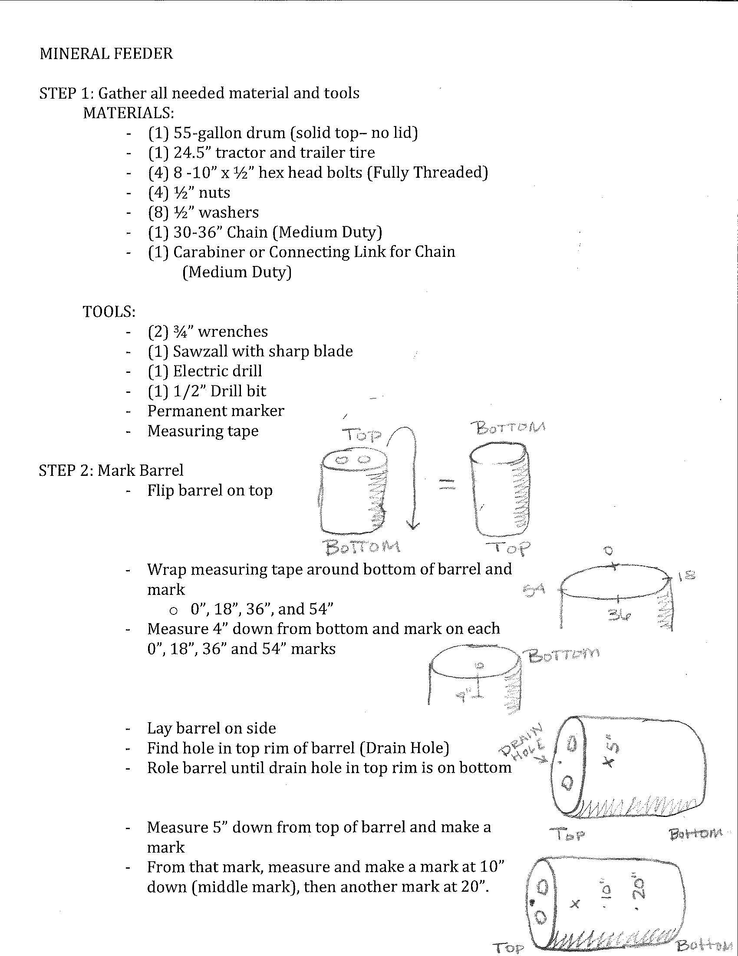
INSTRUCTIONS
M. South, 2019

Slide 23
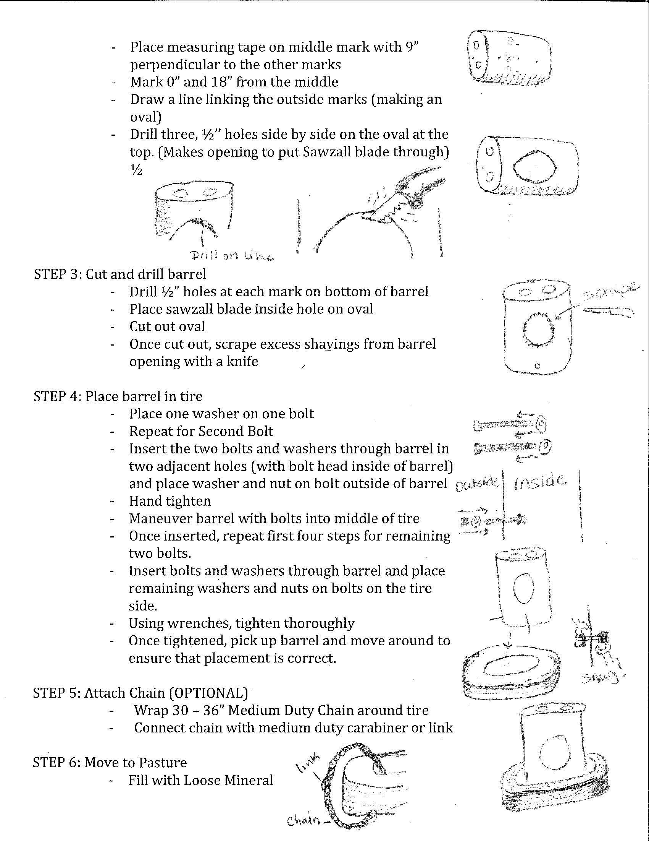
INSTRUCTIONS
M. South, 2019

Slide 24
SOURCES CITED
Hilton, M.. (2014). Nutritional Requirements of Cattle. Merek Manual - Veterinary Manual. https://www.merckvetmanual.com/management-and-nutrition/nutrition-beef-cattle/nutritional-requirements-of-beef-cattle?network=g&matchtype=b&keyword=beef%20cattle%20feed%20requirements&creative=228129188387&device=c&devicemodel=&placement=&position=&campaignid=961493643&adgroupid=46575702406&loc_physical_ms=9010229&loc_interest_ms=&gclid=EAIaIQobChMIjI3y0ojt6AIVBZ-fCh2S9g09EAMYAyAAEgKzhfD_BwE
Poore, M.. (2008). Barrel and Tire Mineral Feeder Construction instructions. North Carolina Cooperative Extension Service. https://cefs.ncsu.edu/wp-content/uploads/amazing-grazing-barrel-mineral-feeder-design-may-2013.pdf?x47549
Rasby, R., Berger, A., Bauer, D., and Brink, D.. (2011). Minerals and Vitamins in Beef Cows. University of Nebraska Extension. EC288. http://extensionpublications.unl.edu/assets/pdf/ec288.pdf\
Ward, M. and Lardy, G.. (2005). Beef Cattle Mineral Nutrition. North Dakota University Extension Service. https://library.ndsu.edu/ir/bitstream/handle/10365/5354/as1287.pdf
M. South, 2019

Slide 25
CONTACT
Michelle South
Extension Agent, Agriculture - Livestock
NC Cooperative Extension
Avery and Mitchell Counties
(828) 387-5748
mcsouth@ncsu.edu
M. South, 2019

